Slide 1







HR Dataset Analysis
Supervised By: Eng. Ahmed Samir
Powered by:
Ministry of Communications and Information Technology (DEPI Program)
Google Data Analyst Specialist CAI2_DAT1_G8

Slide 2






Quanta Femina Team
Group: CAl2_DAT1_G6
Team Members
Nada Youssif | Reham Ashraf | Mai Ayman | Mai Mosaad | Farah Mohamed

Slide 3

Agenda
01
06
Data modeling
Introduction
Collaborative Process
02
Problem statement
07
Analysis & insights
03
Objectives
08
Forecasting
01
Dataset overview
Recommendations
04
09
05
10
Q & A
Data cleaning & preprocessing

Slide 4


INTRODUCTION
Our project uses HR Analytics to identify the main reasons behind employee attrition and predict turnover trends using data insights. It helps organizations keep valuable employees through targeted, proactive actions.
01
02
By analyzing employee demographics, satisfaction, and performance, our project uncovers important workforce patterns. It provides clear, practical recommendations to improve engagement and manage teams more effectively.

Slide 5



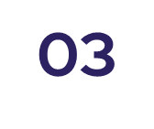
Problem Statement
🔍Lack of Insights:
Many organizations face high attrition without clear understanding of the root causes.
01
.
📉 Underused Data:
Without using historical data, it's hard to predict attrition or connect it with satisfaction and performance.
02
⚠Hidden Risk Factors:
Limited visibility into factors like salary, role, and performance leads to weak retention strategies.

Slide 6

Objectives
01
02
03
04
Detect attrition patterns across demographics (age, Gender , etc.)
.
Analyze the relationship between job satisfaction, performance,
and attrition.
Provide data-driven recommendations to improve employee retention
and workforce management.
Identify key factors contributing to employee attrition.
.

Slide 7






Data Set Overview
This project uses 5 tables
Employees
1470
Education Level
Rating Level
Performance
Satisfaction Level

Slide 8

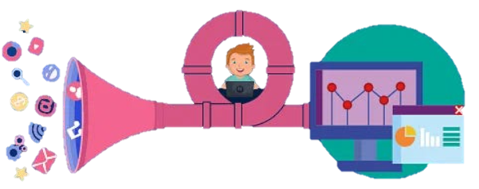
Data Cleaning and Preprocessing
01
Data Understanding:
Before cleaning the data, we first explored its structure, identifying the key attributes, data types, and potential issues.
02
Handling Missing Values (Null):
No missing values were found.
03
Removing Duplicates:
No duplicates found.
04
Data Type Correction (hire dates):
Standardized date formats.
05
Standardizing & Encoding Data (yes,no):
Unified text values , Encoded categorical variables for analysis.

Slide 9
Data Cleaning and Preprocessing
Trim (removing unnecessary spaces):
06
There’s no unnecessary spaces.
07
Outliers (extreme values) numerical column:
No Outliers were found.
08
Correct wrong values (E. L)
If there’s wrong entered values .

Slide 10

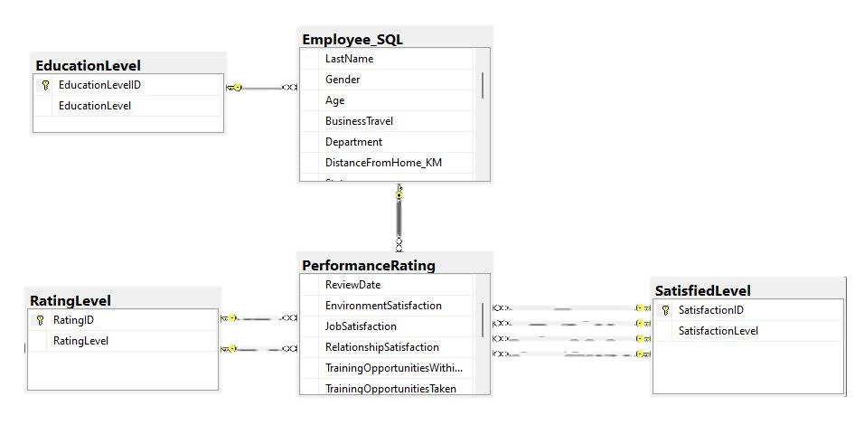
Data Modeling
Integrating all five tables using the primary and foreign keys to create a final dataset for analysis.
Using SQL joins and pandas merge in Python to integrate data.

Slide 11


Analysis Questions
After cleaning and preparing the data, we performed exploratory and analytical queries to uncover key insights.
Employee Demographic
Salary & compensation
Overtime Analysis
Attrition Analysis
Job Satisfaction
Performance Analysis

Slide 12
Employee demographics
Employee Demographics
# No. of employees
% Employee per Education Level
% Age Groups
Gender Distribution
% Employee per department
Average years at company by job role
No. of performance ratings per employees

Slide 13
Attrition
Trends by
Job Role
Department
Impact of
Years at Company
Salary levels
Age group
Job satisfaction
Bonuses
Overtime
Gender

Slide 14
*Job role
*Years of experience
*Education Field
*Salary
*Overtime
*Job Satisfaction
Performance
Varies By:
Impact of:​

Slide 15
*Ages
*Job role
*Gender
*Education Level
* Salary and satisfaction
* Overtime and satisfaction
Job Satisfaction
Varies By:
Relationship Between:

Slide 16
*Average monthly salary across the company.
* Salary differences by job role.
* Salary difference by education level.
*Average monthly salary Per Department
*Average monthly salary Per Department By State
Salary & Compensation
Key insights:

Slide 17
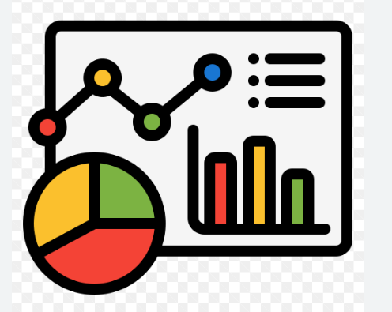
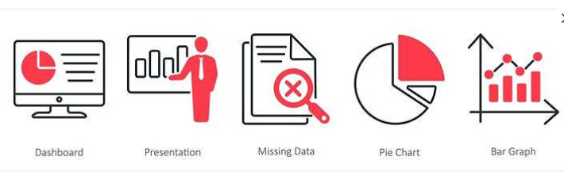
Analysis and Insights
Dashboard section
Employee Dashboard
Attrition Analysis
Job Satisfaction Analysis
Performance Analysis
Salary Analysis

Slide 18
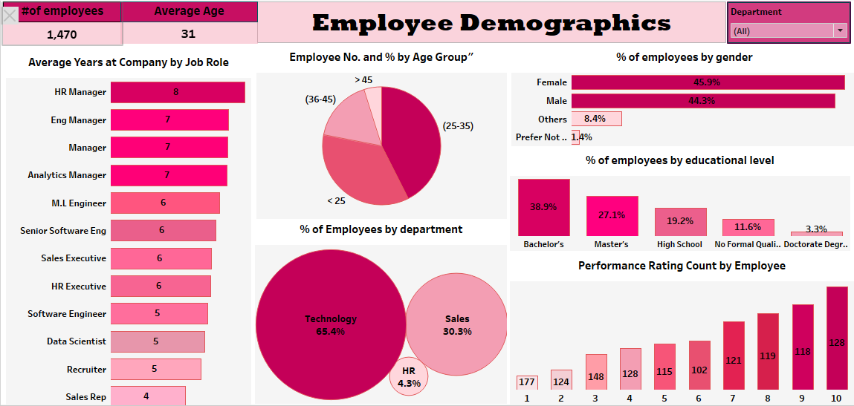

Slide 19
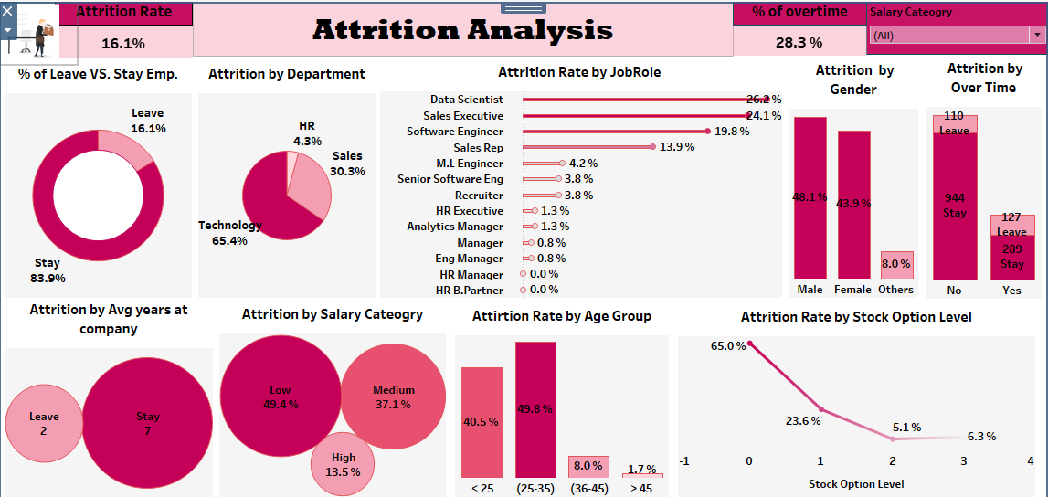

Slide 20
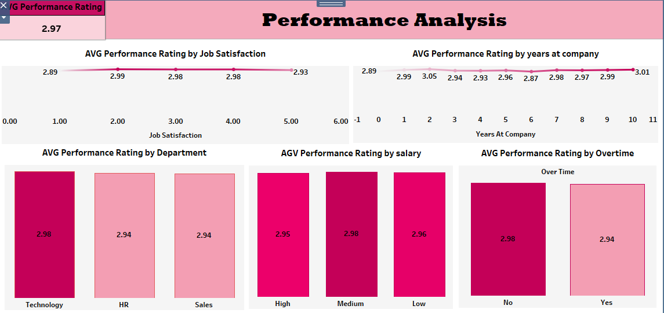

Slide 21
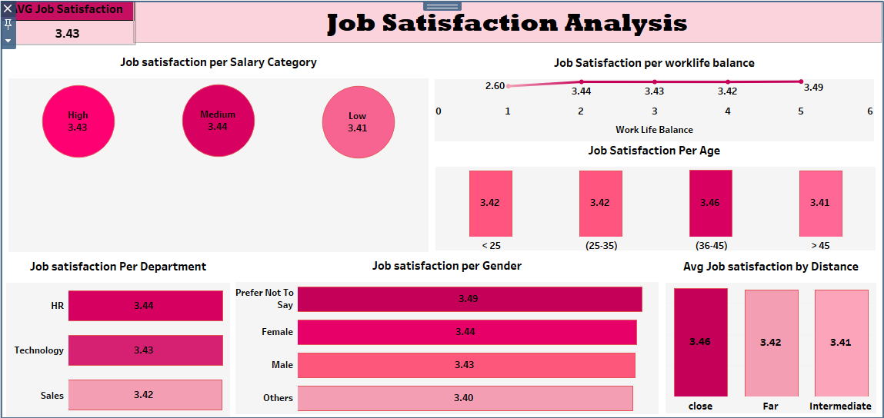

Slide 22
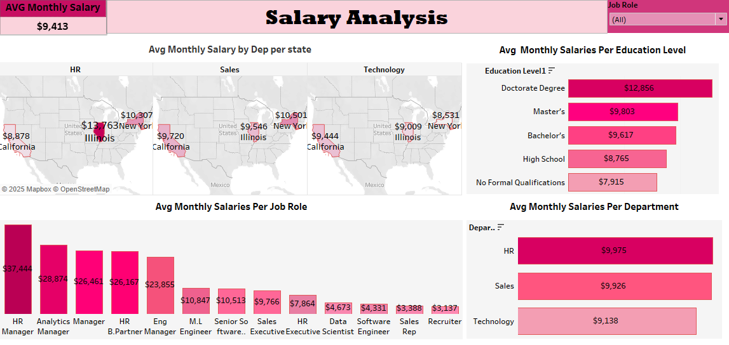

Slide 23
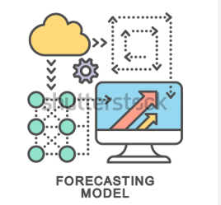
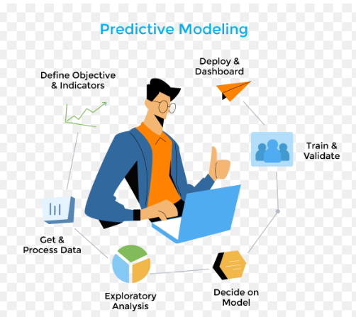
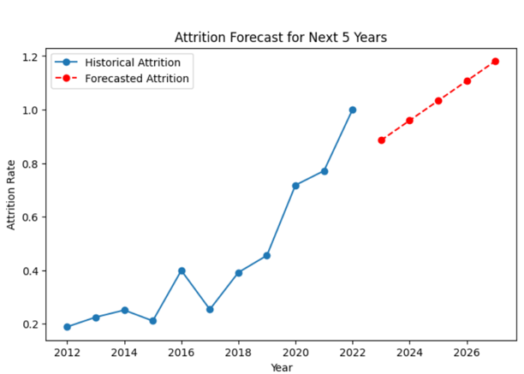
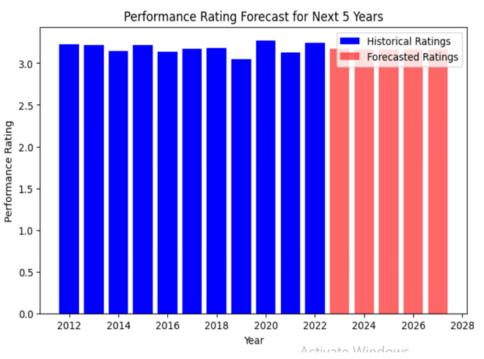
Forecasting
This phase forecasts attrition, salary growth, and performance trends to guide strategic workforce planning and retention
01
📊 Chart 1 – Employee Attrition Forecast (Next 5 Years).
02
📊 Chart 2 – Performance Rating Forecast.

Slide 24
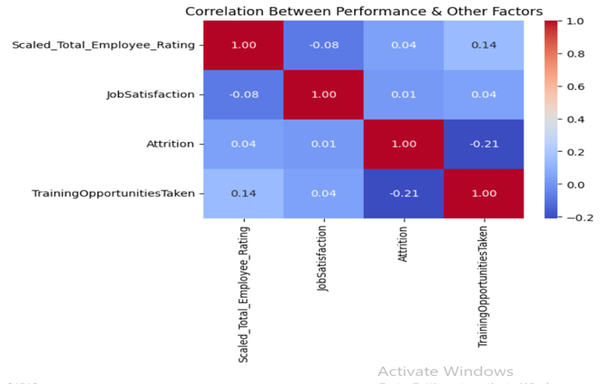

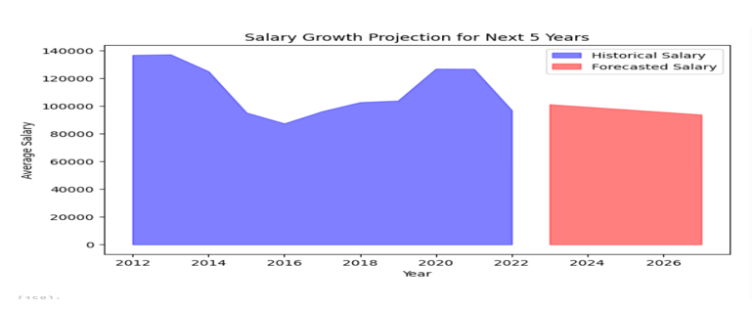
03
📊 Chart 3 – Corrélation Matrix.
04
📊 Chart 4 – Salary Growth Projection.

Slide 25
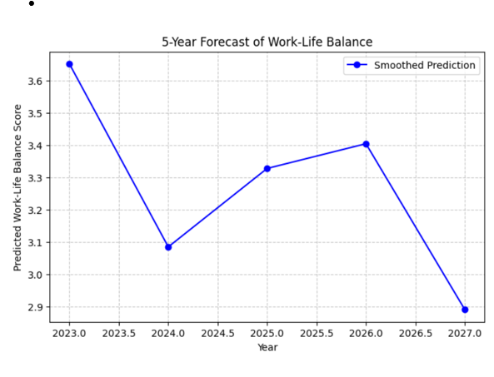
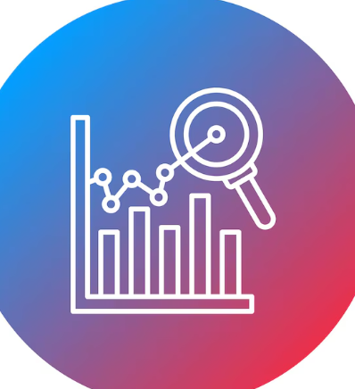
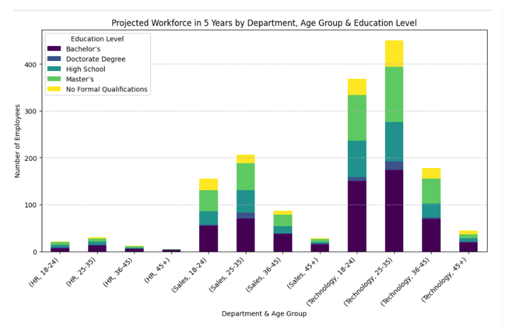
05
📊 Chart 5 – Work-Life Balance & Satisfaction Forecast.
06
📊 Chart 6 – Workforce Education, Age & Distribution Forecast.

Slide 26


Recommendations
Attrition
Competitive salaries
Health & social insurance
Conduct satisfaction
Mental health
Work-load analysis
Conduct exit interviews
Remote work / Flexible
Career progression

Slide 27
Performance
Recognize and reward high performing employees
Retention programs
Enhance training & development
Regular feedback loops
Older employees as consultants

Slide 28

Thank You
We sincerely thank DEPI and the Ministry of Communications and Information Technology of Egypt for giving us the opportunity to explore a new field, providing outstanding materials, dedicated support, and highly skilled trainers. Your efforts have truly empowered us for the future.

Slide 29

Linked in & Get Hub
Linked In
Nada Youssif
Reham Ashraf
Farah Mohamed
Mai Mosaad
Mai Ayman
Get Hub
Check Project Codes & Details

Slide 30


Thank You

Slide 31
Q&A

